Slide 1
Virtual Care
December 14, 2018

Slide 2
National/State Challenges
Why is Telehealth important?
Poor Health Stats
Increase prevalence of chronic disease
Growing Mental Health Need (>44 M adults have AMI)
Aging population
Financial Pressure
Growing population on Medicaid/Medicare
More complexity of disease
Increased comorbidities and need for social services support
Workforce Shortage
Physician & NP shortage
Mental Health provider shortage
Malalignment of Providers to Population

Slide 3
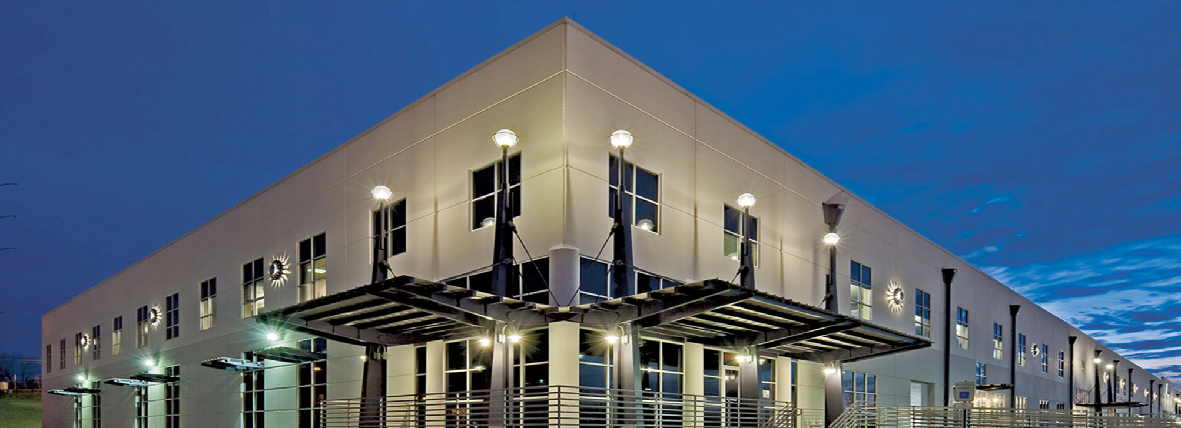
The Future of Integrated Healthcare Delivery
Support services for Ascension focused on enhancing quality, service and experience through coordination and integration of access and navigation services, care management, clinical surveillance and virtual care services

Slide 4

Virtual Care Across Ascension
Care When and Where it is Needed
Virtual Care
and Remote Care
Michigan
Wisconsin
Indiana
Kansas
Connecticut
Illinois
Maryland
Oklahoma
Tennessee
Care coordination/navigation
DTC Urgent Care telemedicine
Telemedicine – Neuro/Psych
Virtual Provider Office
Remote patient monitoring
Alabama
Texas

Slide 5
Current Virtual Care Portfolio
VIRTUAL CARE PROGRAMS:
Behavioral Health |  | Pediatric Dermatology
Cardiology |  | Pharmacy
Dermatology |  | Plastic Surgery
Infectious Disease |  | Primary Care
Neonatology |  | Pulmonology
Neurology |  | Stroke
Orthopedics |  | Urgent Care
Pediatric Behavioral Health |  | Urology
REMOTE PATIENT MONITORING PROGRAMS:
Behavioral Health
Cardiac Rehab
Chronic Obstructive Pulmonary Disease
Congestive Heart Failure
Diabetes
Spiritual Care
Surgical Optimization
Total Joint Replacement

Slide 6
Our Journey 2014-2018
Cardiology | Hospitalist | Oncology | School-based
Dermatology | Infectious Disease | Orthopedics | Stroke
Diabetes | MFM | Palliative Care | Surgery
Emergency Medicine | Neonatology | Pediatrics | Urgent Care
Genetics | Neurology | Renal | Wound Care

Slide 7
The Cost of not rethinking how and where we deliver care….

Slide 8

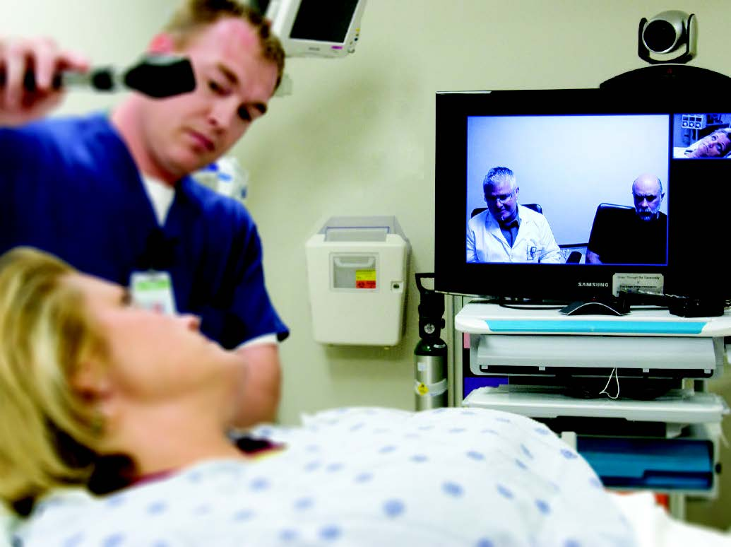
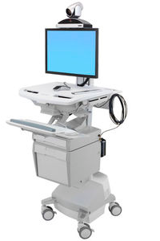
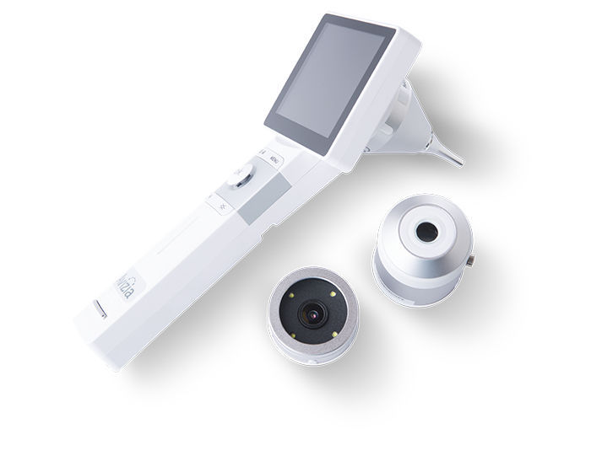

Telemedicine
Easy Access in Convenient Locations
Real-time audio-video consults with specialists
Patients & Providers save time by decreasing drive time & waiting room time

Slide 9
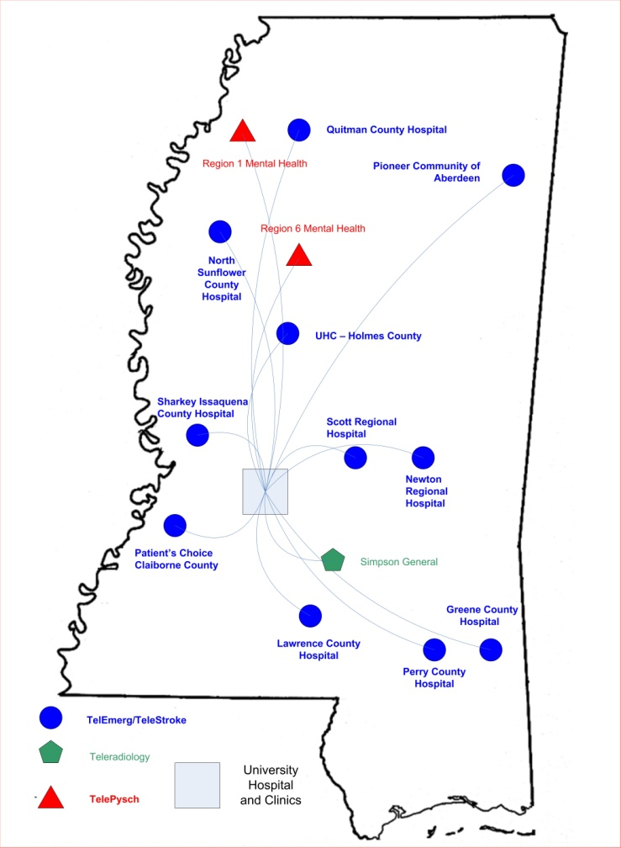
TelEmergency Program Impact
Access to Care
  15 rural MS hospitals
  >300,000 patients treated
Multidisciplinary Team
  NP & Board Certified EM physician
Cost Effective Staffing
  EXPENSE
  25% reduction in staffing costs
Rural Communities Benefit
  20% admissions locally

Slide 10





Digital Clinic
The GoodHealth Digital Clinic offers convenient & affordable medical care to patients wherever they are– at work, at home, or on the go.
^{CONVENIENT}
^{No appointment necessary}
Connect easily from your smartphone
^{AFFORDABLE}
50% less expensive than an urgent care clinic visit and 1/8th of the cost of an ER visit*
^{HIGH QUALITY CARE}
Safe alternative to in-person care for many of the most frequent conditions treated in clinics and emergency rooms
The GoodHealth Digital Clinic is for non-emergency, non-life threatening medical issues. Some common minor illnesses and injuries that can be treated in the digital clinic include:
^{• pink eye}
^{• rashes}
^{• allergies}
OPEN Monday through Friday, 7:00 a.m. to 9:00 p.m.
Saturday and Sunday 9:00 a.m. to 9:00 p.m.
^{• flu symptoms}
^{• sore throats}
^{• upset stomach}

Slide 11
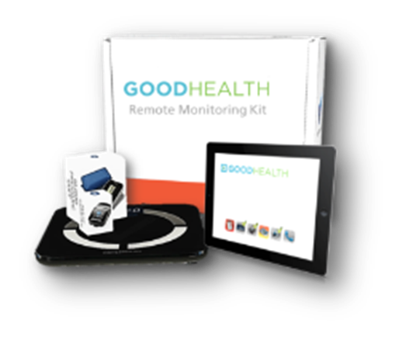



Your Home Clinic that allows us to monitor health data daily for patients remotely, alert physicians when needed, and connect with patients in their homes over video.
Daily Health Sessions
Personalized Interventions
Targeted Education
Health Coaching
Psychosocial Support & Counseling
Behavior Modification
Health Empowerment
Spiritual Care

Slide 12
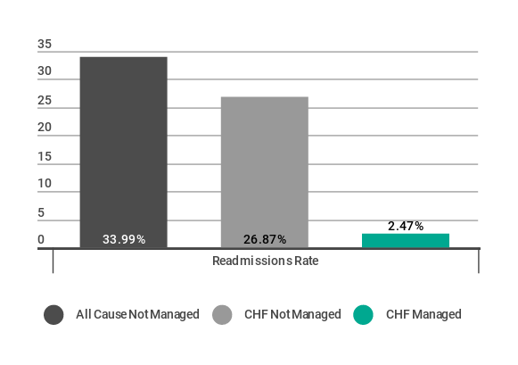
Improving Health
Benefits & Outcomes
CHF READMISSION RATES (FY18)
Around the clock
Monitoring
Measurable Health Results
Patient Friendly Technology
Improved
Patient
Compliance
Access to Care Teams
Lower Cost
800+ patients managed through Remote Patient Monitoring and Care Management
Property of Ascension/Proprietary and Confidential

